Slide 1

Nothing For Us, Without Us
Phylesha Brown-Acton

Slide 2
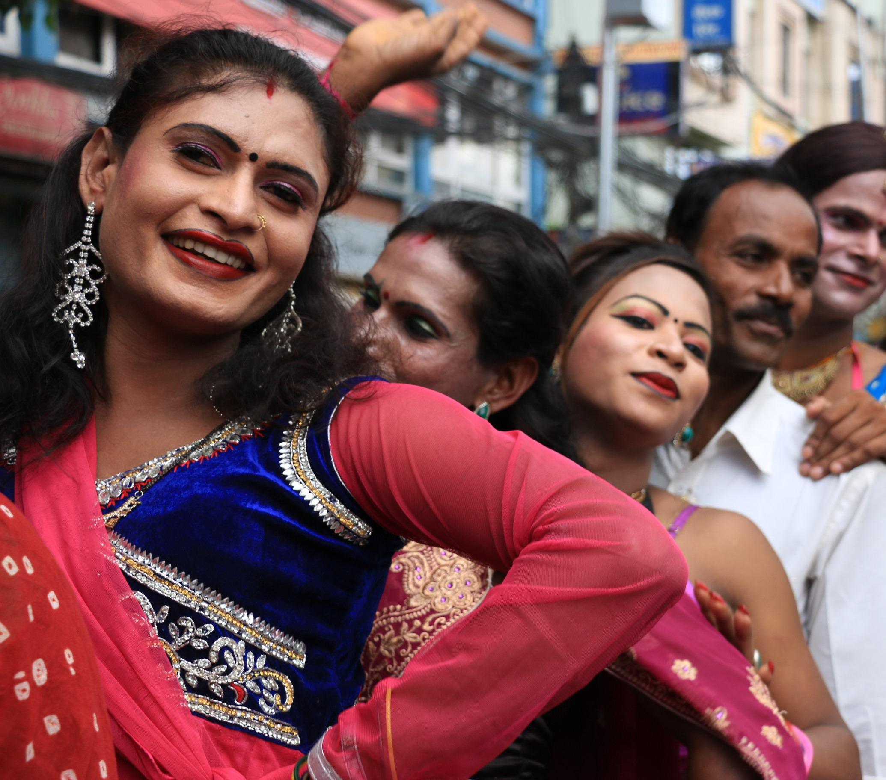
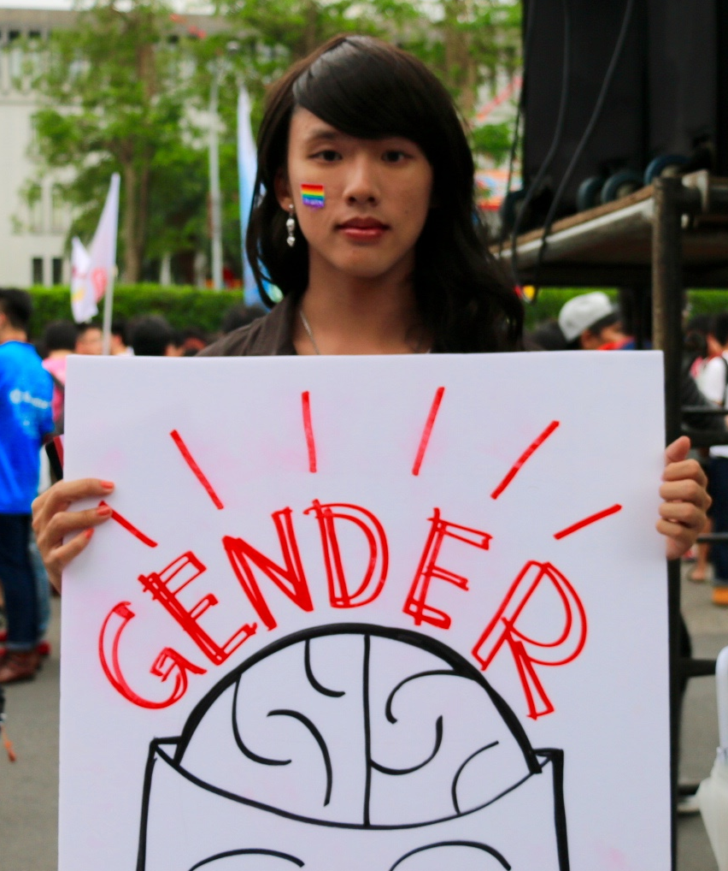

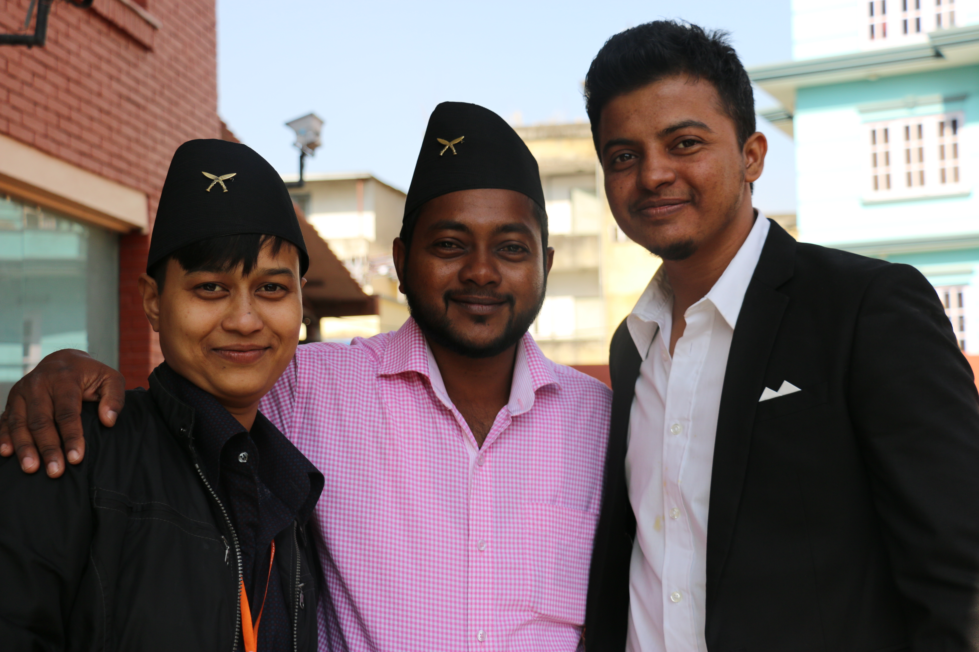
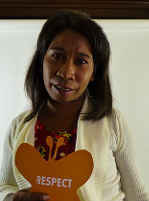


Slide 3
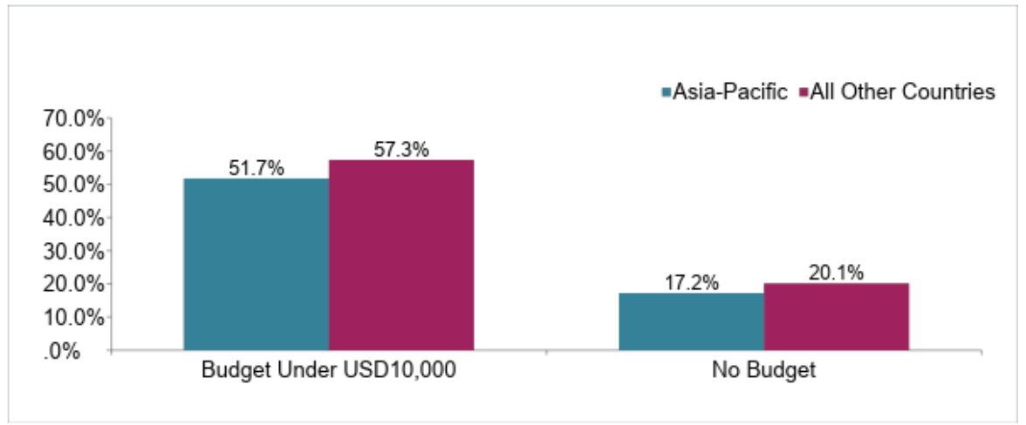
Trans Organisations and Funding
Howe, E, Frazer, S, Dumont, M. and Zomorodi, G. (2017). The State of Trans Organizing (2nd Edition): Understanding the Needs and Priorities of a Growing but Under-Resourced Movement. New York: American Jewish World Service, Astraea Lesbian Foundation for Justice and Global Action for Trans Equality.

Slide 4
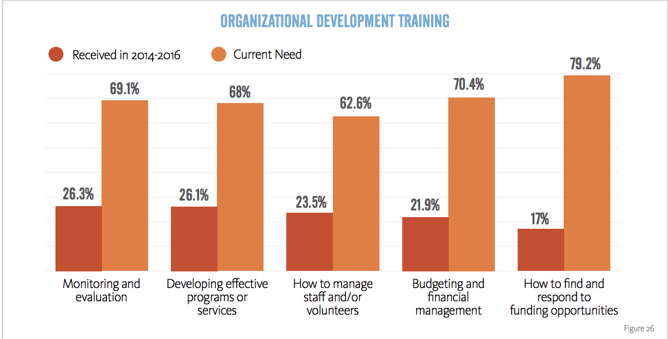
Howe, E, Frazer, S, Dumont, M. and Zomorodi, G. (2017). The State of Trans Organizing (2nd Edition): Understanding the Needs and Priorities of a Growing but Under-Resourced Movement. New York: American Jewish World Service, Astraea Lesbian Foundation for Justice and Global Action for Trans Equality.

Slide 5
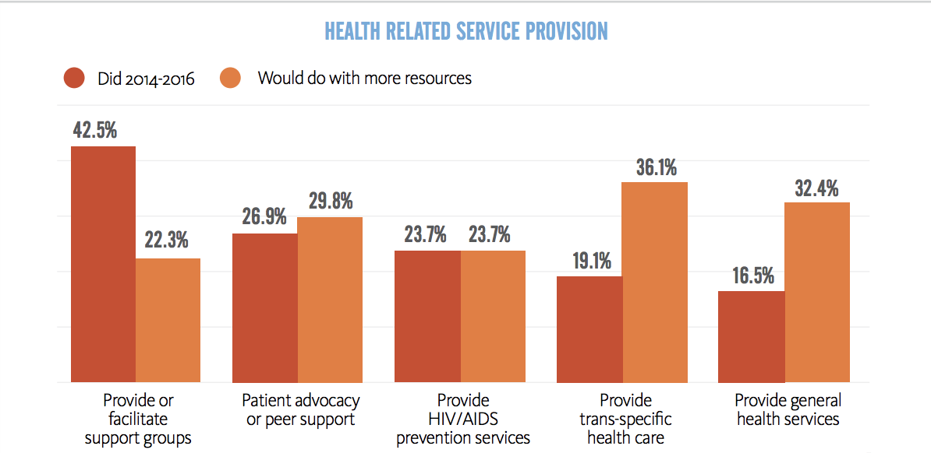
Trans Organisations and Funding
Howe, E, Frazer, S, Dumont, M. and Zomorodi, G. (2017). The State of Trans Organizing (2nd Edition): Understanding the Needs and Priorities of a Growing but Under-Resourced Movement. New York: American Jewish World Service, Astraea Lesbian Foundation for Justice and Global Action for Trans Equality.

Slide 6
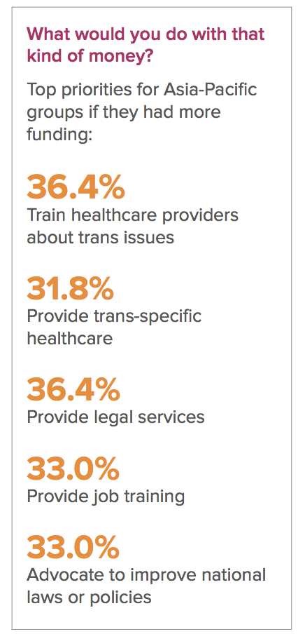
Priorities of Organistions
APTN Report. Increasing Access to HIV and other Health Related Services for Trans People in Asia and the Pacific. 2018/

Slide 7
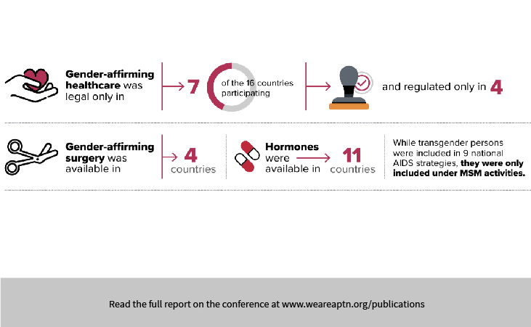
Access to Care
APTN Report. Increasing Access to HIV and other Health Related Services for Trans People in Asia and the Pacific. 2018/

Slide 8
What Is Needed
Disaggregated data: trans men, trans women, gender diverse/NB
PrEP research and campaigns specifically for trans people
Decriminalisation
Integrated health services: gender affirming care!
Gender Recognition
Provision of care BY trans people FOR trans people
Meaningful + PAID inclusion

Slide 9
We must include
Intersectionality and HIV: our peers that are sex workers, differently abled, people of color, religious
Core funding + Capacity Building
Mental health and wellbeing
Comprehensive healthcare that is sensitized for the needs of trans people
Affordable and accessible PrEP + ART medication

Slide 10
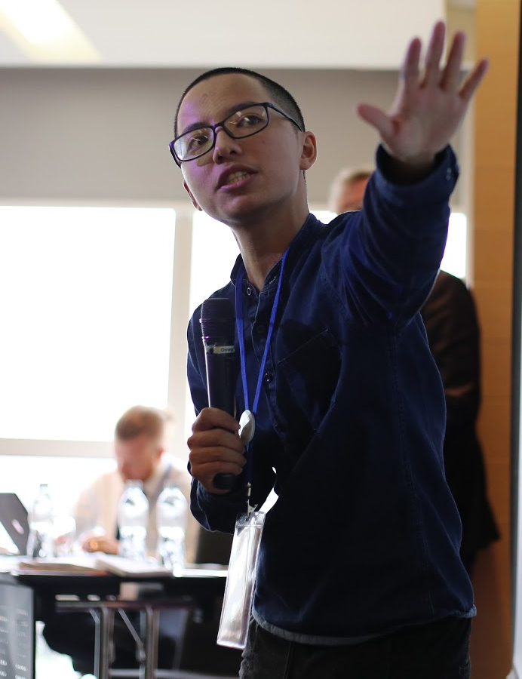

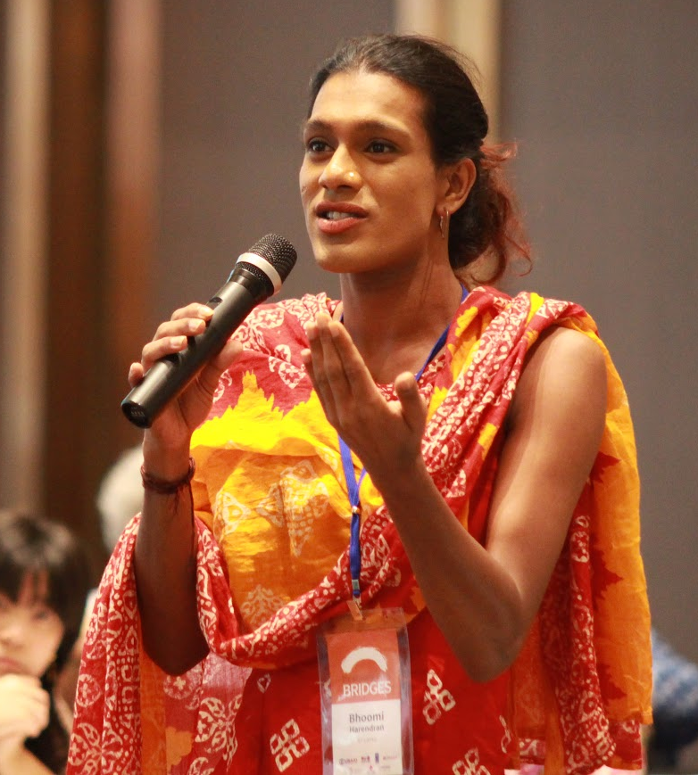



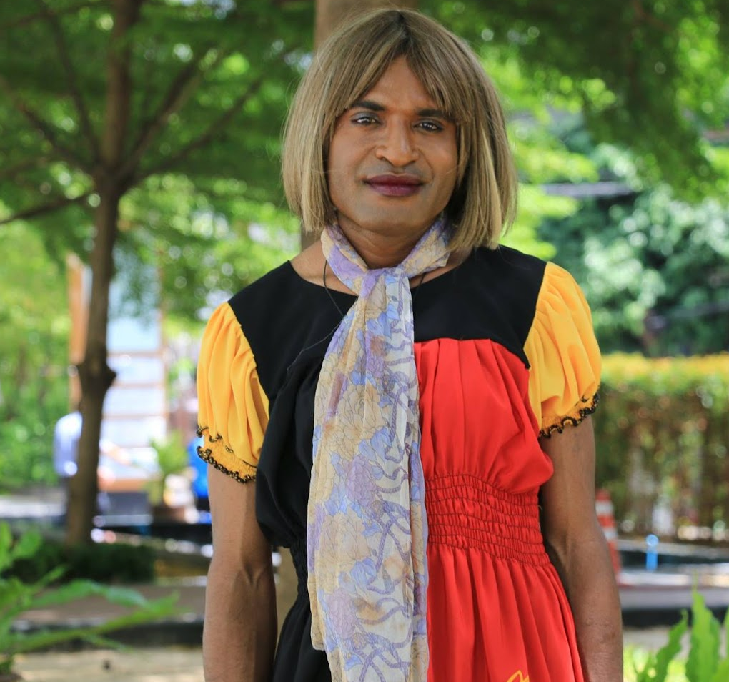


Slide 11
Nothing For Us, Without Us

